Slide 1
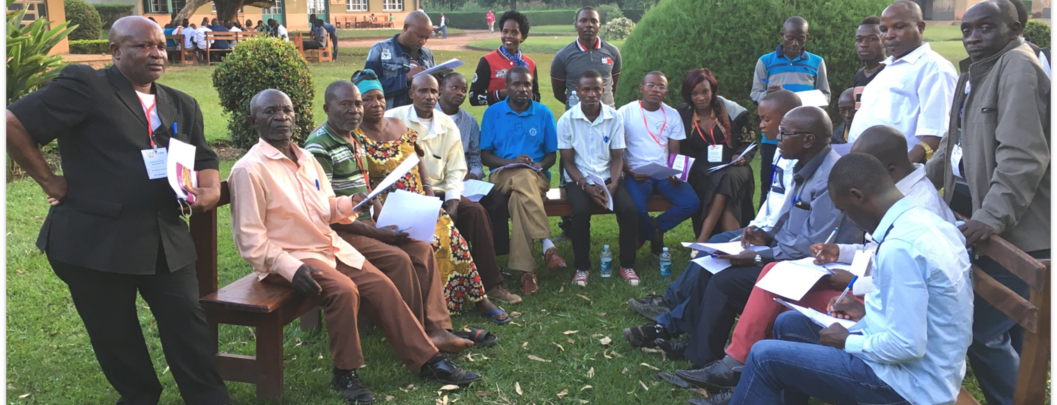
Church Owned Bible Translation
Keep your heart safe and guard it with all diligence, for from it flow the springs of life (Prov. 4:23).
Walk in wisdom toward those who are outside, redeeming the time (Col. 4:5).
All Scripture taken from the English Unlocked Literal Bible (ULB), ©2017, 2022 Wycliffe Associates, Available at https://bibleineverylanguage.org/translations, licensed under the Creative Commons Attribution-ShareAlike 4.0 International License.
The English ULB is based on the unfoldingWord® Literal Text, CC BY-SA 4.0. The original work of the unfoldingWord® Literal Text is available at https://unfoldingword.bible/ult/.
Six Behaviors

Slide 2
?
What actions do we see in a local church that believes in COBT?

Slide 3
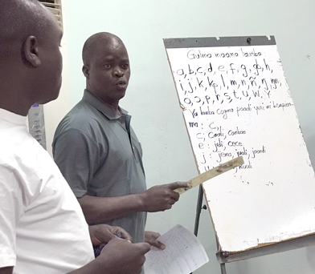

1. Accept the responsibility to do a Bible translation
Takes
Responsibility
Local Church
Bible translation
They read in the book, The Law of God, making it clear with interpretation and giving the meaning so the people understood the reading (Nehemiah 8:8).

Slide 4
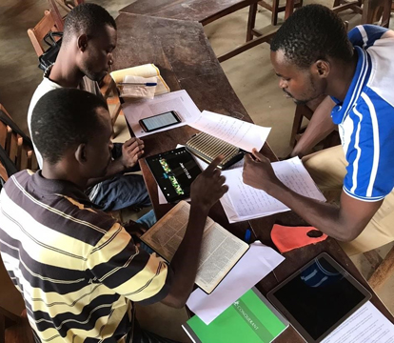

2. Make Bible translation accessible
Manages
Accessibility
Local Church
Thereafter every day, in the temple and from house to house, they were continuously teaching and proclaiming the good news that the Christ is Jesus (Acts 5:42).

Slide 5

3. Refine and revise the translation
Checking
Refine
Translate
Revise
Local Church
Let us not become weary in doing good, for at the right time we will reap a harvest, if we do not give up (Galatians 6:9).

Slide 6
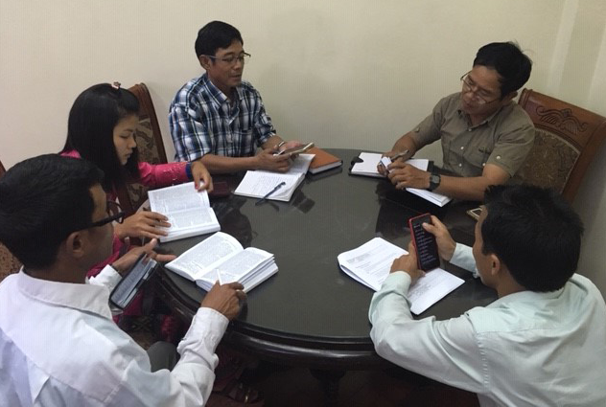
4. Engage community in using Scripture
All scripture has been inspired by God. It is profitable for doctrine, for conviction, for correction, and for training in righteousness. ¹⁷ This is so that the man of God may be competent, equipped for every good work (2 Timothy 3:16-17).

Slide 7
5. Share COBT with others
He answered and said to them, "If someone has two tunics, he should share with a person who has none, and the one having food should do the same.“ (Luke 3:11)

Slide 8
6. Lead future generations to update and revise.
You
Your children
Your grandchildren
The words that I am commanding you today will be in your heart; ⁷ and you will diligently teach them to your children; you will talk about them when you sit in your house, when you walk on the road, when you lie down, and when you get up (Deuteronomy 6:6-7).
They read in the book, The Law of God, making it clear with interpretation and giving the meaning so the people understood the reading (Nehemiah 8:8).

